Slide 1
Are the GDPR restrictions on profiling compatible with the development of Artificial Intelligence and Machine Learning?
Bradley Joslove
Partner - Franklin

Slide 2
Artificial intelligence and big data
2.5 quintillion bytes of data are created each day
90% of the data in the world was generated over the last 2 years
Every minute
Google processes more than 2.4 million searches
Users watch more than 4 million Youtube videos
16 million text messages and 156 million emails sent
More than 500,000 photos shared on Snapchat
More than 500,000 comments posted on Facebook
More than 450,000 tweets sent on Twitter

Slide 3
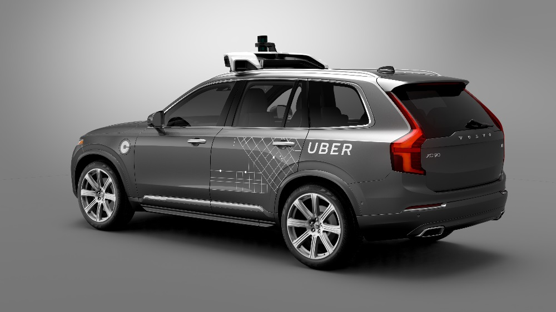
Applications of artificial intelligence and machine learning

Slide 4
Potential concerns attached to the growth of AI
Privacy concerns
Risk that companies collect disproportionate amounts of personal data to feed their AI
Lack of transparency and reliability
Growing concern since cars, pacemakers, power grids, and even lethal autonomous weapons are increasingly controlled by algorithms and AI
Fear that humans may lose control over machines
Algorithmic biases and discrimination
Ex: a study showed that an algorithm used in a company’s hiring processes learned that “English” names were generally associated with acceptable qualifications while “foreign” names were not

Slide 5
Artificial intelligence, machine learning and the GDPR
Purpose limitation
Data minimization
Automated decision-making
Limits imposed by the GDPR
Transparency and information obligations
Obstacles to transparency
Explainable AI
Privacy by design and by default
Conclusion

Slide 6
Purpose limitation
Article 5.1(b) of the GDPR: personal data must be collected for specified, explicit and legitimate purposes and not further processed in a manner that is incompatible with those purposes
Tension: Artificial Intelligence may use personal
data for a purpose different from that for which it was
originally collected
Possible only if the purposes of the AI are not
incompatible with that of the initial processing

Slide 7
Data minimization
Articles 5.1(c) and 5.1(e) of the GDPR: Organizations must minimize the amount of data they collect and process, and the length of time they keep the data
Tensions with AI and machine learning:
AI tends to involve collecting and analyzing as much data as possible
Tendency that personal data is collected and kept “just in case” it proves useful for future AI projects
It is necessary to ensure that personal data used for AI are necessary and relevant
It is also mandatory to comply with the storage limitation principle

Slide 8
Profiling
For reasons of time, this presentation will not delve into the issue of profiling for direct marketing purposes and the rights of data subjects in this regard, except as concerns profiling that involves automated decision-making

Slide 9
GDPR restrictions on automated decision-making
Article 22 of the GDPR : Right not to be subject to a decision based solely on automated processing, including profiling, which produces legal effects or similarly significantly affects the data subject
Examples: automatic refusal of an online
credit application, e-recruiting practices
without any human intervention, etc.
Human intervention must be meaningful

Slide 10
Exceptions
Automated decision-making may be justified by one of three exceptions:
necessary for entering into or performance of a contract
explicit consent of the data subject
processing authorized by law

Slide 11
Safeguards – Suitable Measures
Even when an exception applies, the controller must implement “suitable measures” to safeguard the rights of the data subjects (art. 22 and Recital 71)
Right to obtain human intervention
Right for individuals to obtain an explanation and to express their point of view
Right for individuals to contest the decision
Decisions cannot be based on sensitive data except in limited circumstances
Should not concern a child

Slide 12
Transparency and information obligations
Articles 13 and 14 of the GDPR: Right to be informed of
The existence of automated-decision making
The logic involved (the rationale or the criteria relied on in reaching the decision)
The significance and the envisaged consequences of such processing

Slide 13
Obstacles to transparency
Explainability could run counter to trade secrets and/or give competitors economically valuable information or ability to circumvent proper functioning of the AI (e.g. Google search engine)
Complexity of machine learning makes it difficult to understand how an automated decision-making process works and to explain the criteria it uses to make a decision
Opacity of most Artificial Intelligence (« black-box » AI, neual networks)
AI’s learning process can consist of millions of steps and is difficult to trace backwards.
Some decision-making processes are not understandable to humans. Example: Google’s AlphaGo chess moves.

Slide 14
Explainable Artificial Intelligence
Machine-learning scientists focus on making AI processes more transparent
Several ways AI processes can be made explainable
Risk: Constraint on the algorithms used

Slide 15
Privacy by design and by default
Anonymization and pseudonymization techniques
Risk: techniques that could make AI less efficient
Differential Privacy (Apple, Google)
Truata
Data minimization, purpose limitation, procedures to prevent errors, inaccuracies and discrimination, etc.

Slide 16
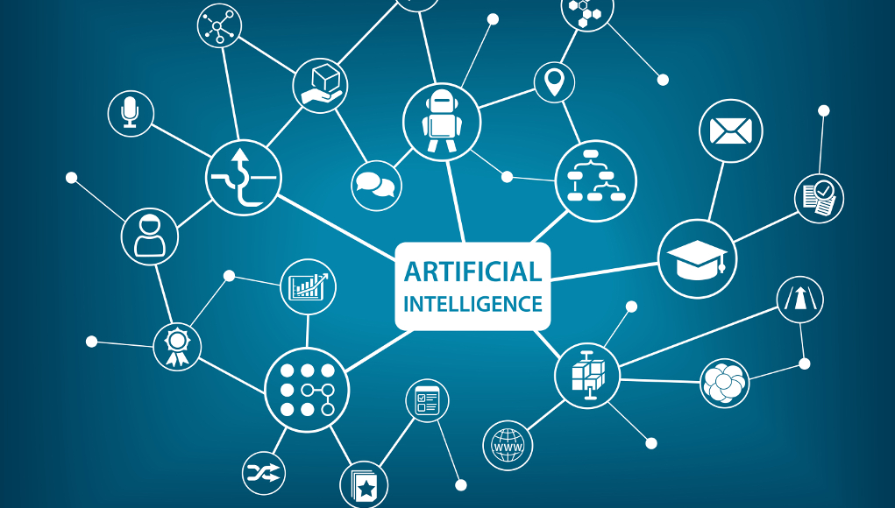
Transparency and ethics: new imperatives for AI
AI cannot truly take off if people don’t trust it and trust requires explainability. Shining a light on AI can limit the potential of AI as currently conceived, but it could also push it in a better direction, make it less biased, more accurate and more subject to human control.

Slide 17
Thank you for your attention
Bradley Joslove
bjoslove@franklin-paris.com
+ 33 (0)1 45 02 79 00
www.franklin-paris.com

